Slide 1
Lecture 11b
Introduction to Spark

Slide 2

Hadoop: Pros
In Hadoop, Data is highly available and accessible.
It is highly scalable (we can easily add the new nodes on the fly without any downtime.)
It is fault tolerant as by default, 3 replicas of each block are stored across the cluster.
Hadoop runs on a cluster of commodity hardware which is not very expensive.
Hadoop is very easy to use, as there is no need of the client to deal with distributed computing; the framework takes care of all the things.

Slide 3

Hadoop: Drawbacks
Issue with small files
Chunk size must be very large
Slow processing speed
No caching
No real time data processing
Support for batch processing only
Not support code iteration
Security issues
…

Slide 4

How to overcome most of these problems …

Slide 5


Spark
Developed as a research project at UC Berkeley AMPLab
“Spark: Cluster Computing with Working Sets”, first published in 2010 at HotCloud'10 Conference Proceedings
Goal: “Support a much wider class of applications than MapReduce, while maintaining automatic fault tolerance”

Slide 6

Spark Capabilities (Hadoop Shortcomings)
Performance
Use RAM
Ease o Use
Python, Java, Scala: first class citizens
New Paradigms
SparkSQL, Streaming, Mlib, …

Slide 7
Spark supports a much wider class of applications
Why need to support a much wider class of applications?
Multipass applications with low-latency data sharing requirements
Common in data analytics
Iterative algorithms: machine learning and graph algorithms
Interactive data mining: load data into RAM across a cluster and query repeatedly
Streaming Applications: maintain aggregate state over time

Slide 8
How Spark solve these problems?
In-memory cluster computing
Unified Engine with RDD

Slide 9
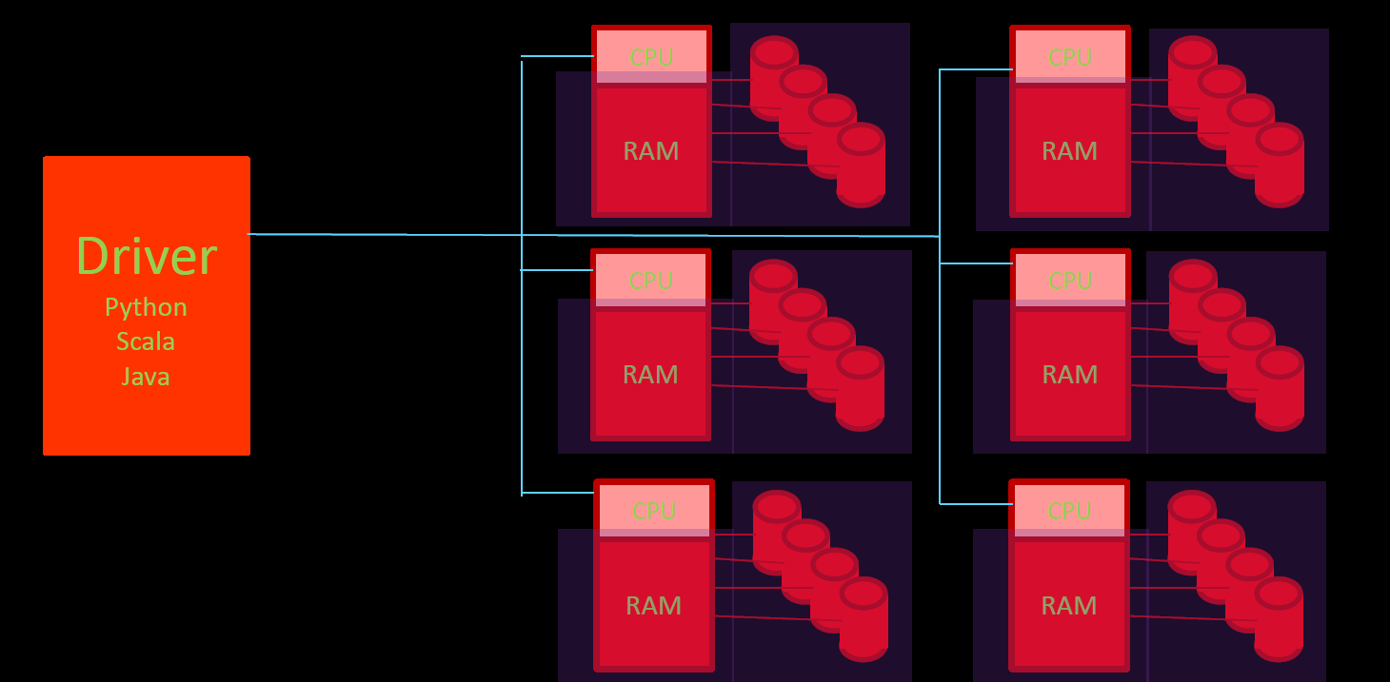
Same MapReduce Idea (but improved)
RAM: RDD (Resilient Distributed Datasets )

Slide 10
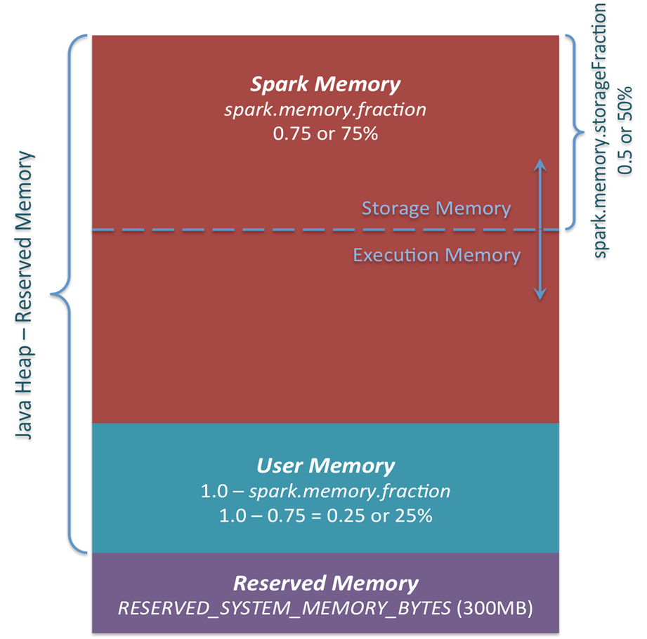
Resilient Distributed Datasets (RDDs)
RDDs reside in Spark memory
Spark memory distinguishes from user memory
A sample Spark memory allocation shown in Figure
RDD makes it possible for data sets to be shared in memory across Spark jobs
RDD: Solution to Too Much Data Movement

Slide 11
RDD Dataflow
RDD
RDD
RDD
HDFS
Load
Map
Reduce
Load
Map
HDFS
Reduce
Lineage:
Load
Map
Reduce
HDFS
RDD
RDD
RDD
Based on Source Graphic by Earl Lawrence

Slide 12
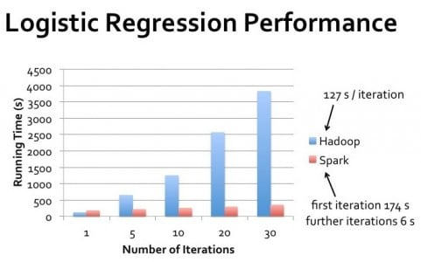
Performance: Spark vs. Hadoop
Activity:
For one iteration, Spark performance is better than as Hadoop?
Explain the reason why as number of iteration increases Spark performs much better than Hadoop?
https://www.datamation.com/data-center/hadoop-vs.-spark-the-new-age-of-big-data.html

Slide 13
Spark (delayed) Actions
Create/Load RDD
e.g. Read a webpage visitor IP address log
rdd1 = sc.textFile(“visitor-log.csv”)
Transform RDD
e.g. filter out all non-US IPs
rdd2 = rdd1.filter(lambda entry: “US” in entry)
Lazy Evaluation
Wait, we are not creating a new rdd2 yet - Don’t do anything till data is actually needed;
Maybe more transforms needed (e.g. find out distinct IP addresses)
rdd3 = rdd2.distinct()
Perform action when data to be returned
Count how many unique US visitors
rdd3.count() #this line of code forces the system to create rdd3
sc: Spark Context

Slide 14
Spark Context
The first thing a Spark program requires is a context, which interfaces with the computing cluster
PySpark shell provides a convenient sc using the local system
For standalone program, you may specify:
from pyspark import SparkConf, SparkContext conf = SparkConf().setMaster("local").setAppName("Test_App") sc = SparkContext(conf = conf)
Typically we run the scripts using
spark-submit Test_App.py

Slide 15
Using Shell
> pyspark
> spark-shell
These already have SparkContext created as “sc”

Slide 16
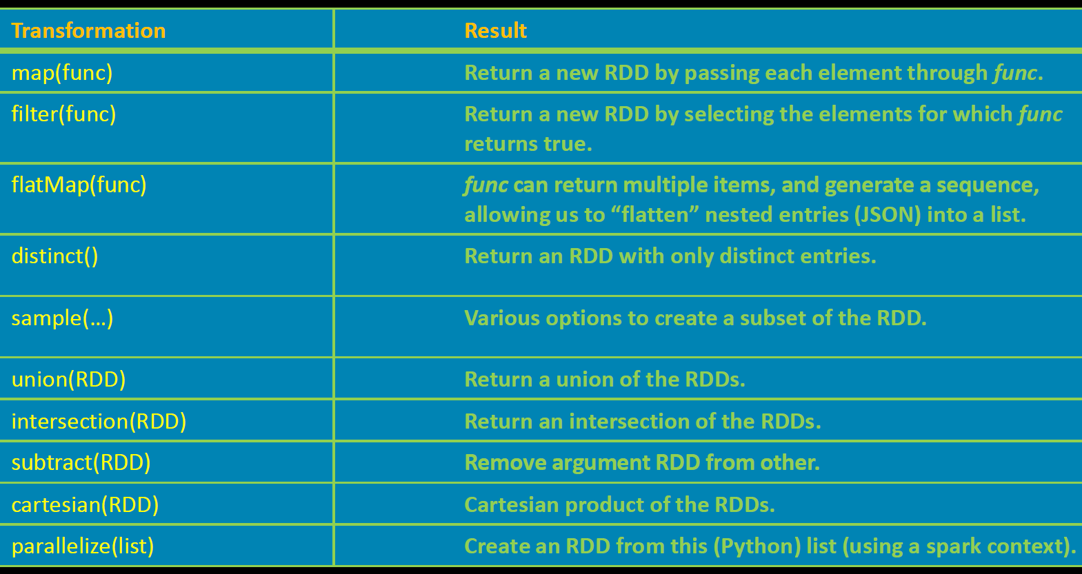
Common RDD Transformations

Slide 17
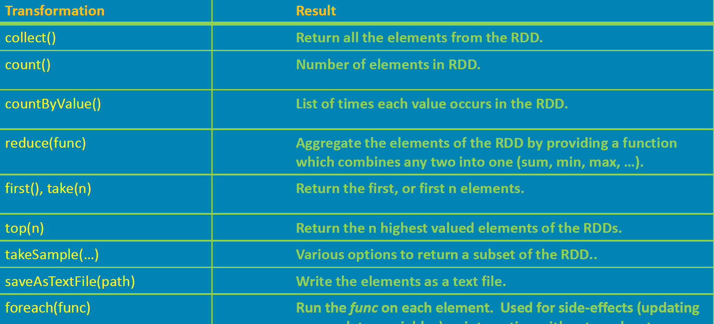
Common Actions
Complete list of transformations and actions at http://spark.apache.org/docs/latest/api/python/pyspark.html#pyspark.RDD

Slide 18
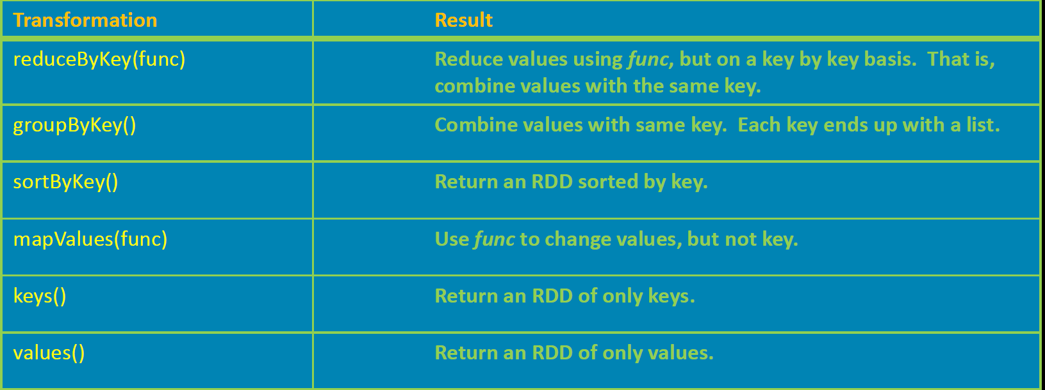
Key-Value Pair RDDs

Slide 19
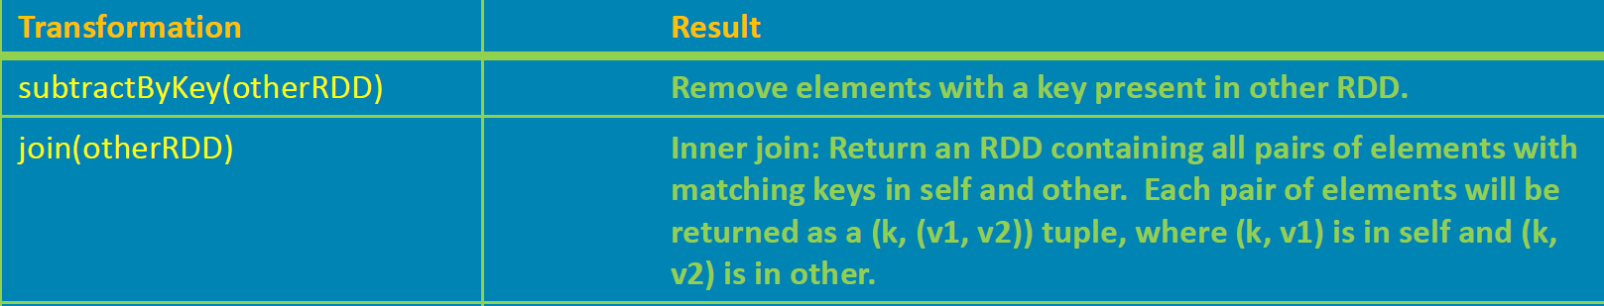
Two Pair RDD Transformations
Example:
x = sc.parallelize ([(“dogs”, 2), (“cats”, 4)]) #here parallelize creates an RDD x from a list
y= sc.parallelize([(“dogs”, 3), (“dogs”, 5)])
z= x.join(y)
z.collect()
Now z is [(“dogs”, (2, 3)), (“dogs”, (2, 5))]

Slide 20
Example: Simple WordCount
rdd= sc.textFile(“shakespeare.txt”) #read in data sets to RDD
rdd.count() #number of lines
words= rdd.flatMap(lambda x: x.split() ) #word split
words.count() #number of total words
words.distinct().count() #number of distinct words
word_counts= words.map(lambda x: (x,1)) #create an rdd of tuples
.reduceByKey(lambda x,y: x+y) #reduce tuples by word
result= word_counts.map(lambda x: (x[1], x[0])) #swap key and value
.sortByKey(False) #sort by key, descending
#now the result contains a list of (count, word) tuples
#where count is the frequency of a word with most frequent word on top
result.take(5) #collect the top 5 (count, word) pairs

Slide 21
Spark Execution Environment
Spark is a fast and general processing engine compatible with Hadoop data.
It can be a part of Hadoop ecosystem
Can run in Hadoop clusters through YARN
Can process data in HDFS, HBase etc.
It can also run in Spark’s standalone mode without using HDFS
Detailed application job submission instructions may vary by different systems
Here we provide a general guideline with primary reference available at
https://spark.apache.org/docs/latest/submitting-applications.html

Slide 22
Installing PySpark on Windows (optional)
Install Java JDK
Add JAVA_HOME environmental variable
Install Python 3
Select option to add Python to PATH
Download a Hadoop Binary (Windows specific issue)
Recall that Spark uses HDFS to work with files rather than NTFS like Windows
Extract to any directory ..\Hadoop
Create a HADOOP_HOME environment variable pointing to the installation folder
Add %HADOOP_HOME%\bin to the Windows Path variable
In command line: pip install pyspark

Slide 23
Summary
Activity (quick answer):
What does RDD stand for?
Write code to read in Exam 1 test scores and store in a RDD
Spark is an improvement over Hadoop
Key to Spark: RDDs
While ideal to run Spark jobs on high performance computing cluster (HPC), Spark works well in a PC environment
Next Lecture: Security and Privacy Issues in Big Data

